Slide 1
Efficacy evaluation of ISOCLAST against Philaenus spumarius on weeds in semi-field, Italy, 2017.
David Valcárcel Herrera
Supervised by Miguel Rodrigo Valverde Urrea

Slide 2
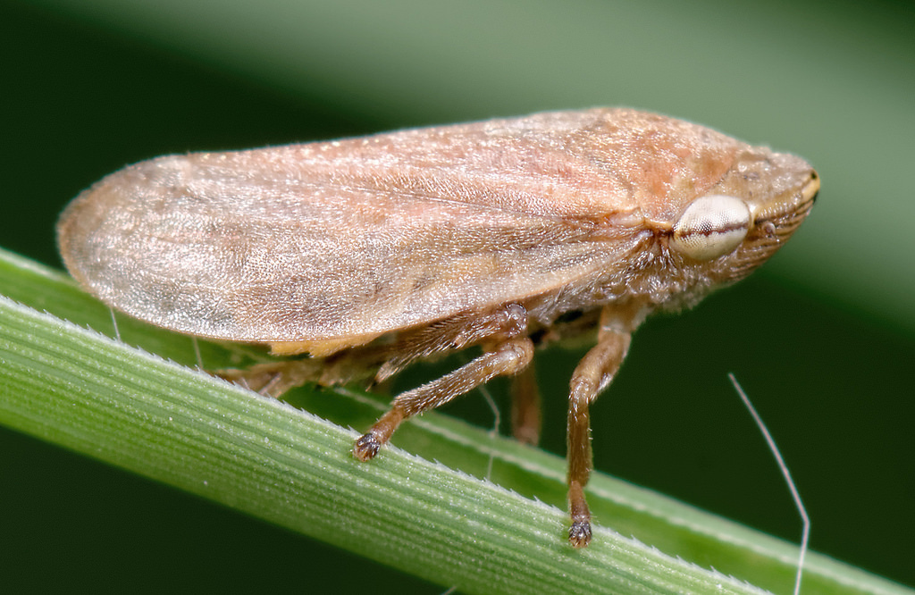
INTRODUCTION (BACKGROUND)
Background: Philaenus spumarius (“meadow spittlebug”) is a major vector of Xylella fastidiosa (also known as Pierce’s disease), a devastating plant pathogen in Europe.
Effective control of P. spumarius is important for managing Xylella outbreaks and ensuring crop health.
Several insecticides, including ISOCLAST™ (sulfoxaflor), are available to control sap-feeding pests such as the aforementioned. There is a need to assess and compare their efficacy and persistence of these products under semi-field conditions.
This photograph is from https://www.marylandbiodiversity.com/species/11054 is under license CC BY

Slide 3
INTRODUCTION (OBJECTIVES OF THE STUDY)
Key Objectives:
Identify the most effective treatment/insecticide
It must be determined which of the tested products (see 2017 and 2018 tables) provides the highest efficacy against Philaenus spumarius under semi-field conditions in each year by studying the effects on cumulative mortality. We must also study if there is variability between plots, that is, if the plots have something to do with the differences between individual replicas.
Compare application methods
It must be assessed whether foliar spray or trunk injection is more effective for delivering each treatment.
Evaluate persistence of control
We should also measure how persistent each treatment is over time, and identify which offers the longest-lasting protection.

Slide 4
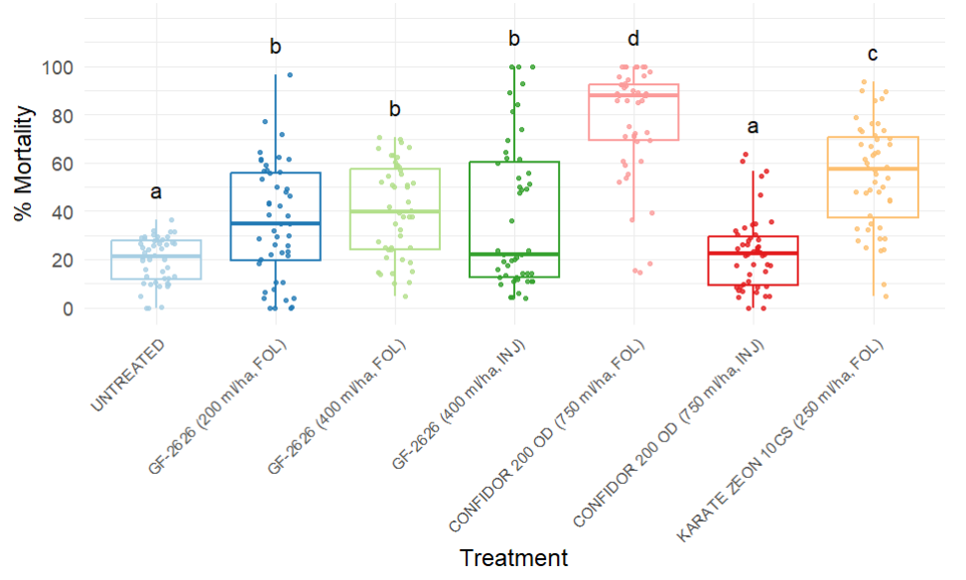
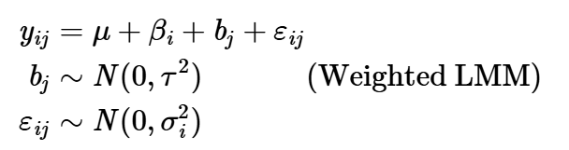
1. Which insecticide is more effective against Philaenus spumarius? (2017)
Among all treatments in 2017, a foliar application of CONFIDOR 200 OD was the most effective against P. spumarius, followed by Lambda-cyhalothrin (KARATE ZEON 10 CS) and lastly, sulfoxaflor treatments.
An application of CONFIDOR 200 OD via trunk injection has no effect on mortality.
There appears to be no significant difference in mortality between sulfoxaflor (GF-2626) treatments, regardless of application and rate, but there is a significant difference with respect to control.
INJ – trunk injection
FOL – foliar application

Slide 5

1.5. Variability between plots (2017)
The treatment alone explains nearly all of the variability in the data that is accounted for by the selected model (27.9% out of 29.08%). This means that 70.92% of the variability remains unexplained by the model — likely due to other variables not included in the analysis, environmental conditions and/or unknown interactions.
The plots (the random effect in the model) explain only 1.13% of the variance, indicating that plot-to-plot differences have very little influence on mortality in this experiment.

Slide 6
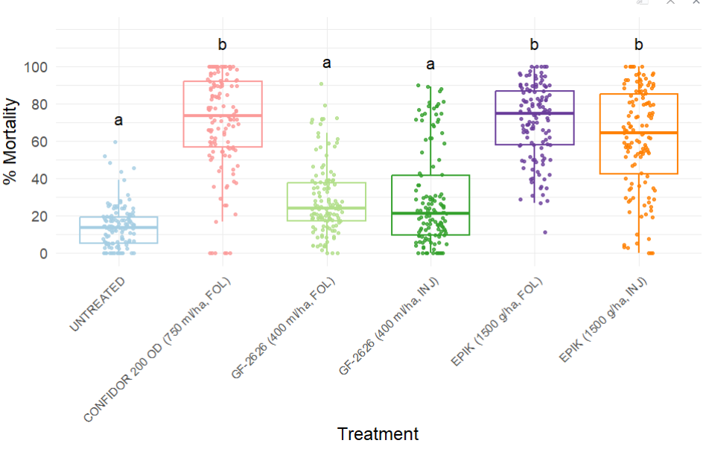
1. Which insecticide is more effective against Philaenus spumarius? (2018)
We can see that, among all treatments in 2018, a foliar application of CONFIDOR 200 OD or EPIK (regardless of dosage or application) have the biggest impact on mortality as shown in the graph, compared to sulfoxaflor treatments (regardless of application).
There are two groups of treatments, a group consisting of the three ones previously described, which are statistically different to the control and another group consisting on the sulfoxaflor treatments, which are not significantly different to the control.
INJ – trunk injection
FOL – foliar application

Slide 7

1.5. Variability between plots (2018)
The treatment alone explains most all of the variability in the data that is accounted for by the selected model (54.36% out of 69.73%).
The plots (the random effect in the model) in this experiment in 2018 explain about 15.38% of the variance, indicating that plot-to-plot differences have some influence on mortality, yet it is negligible compared to the influence the treatment has on mortality.

Slide 8
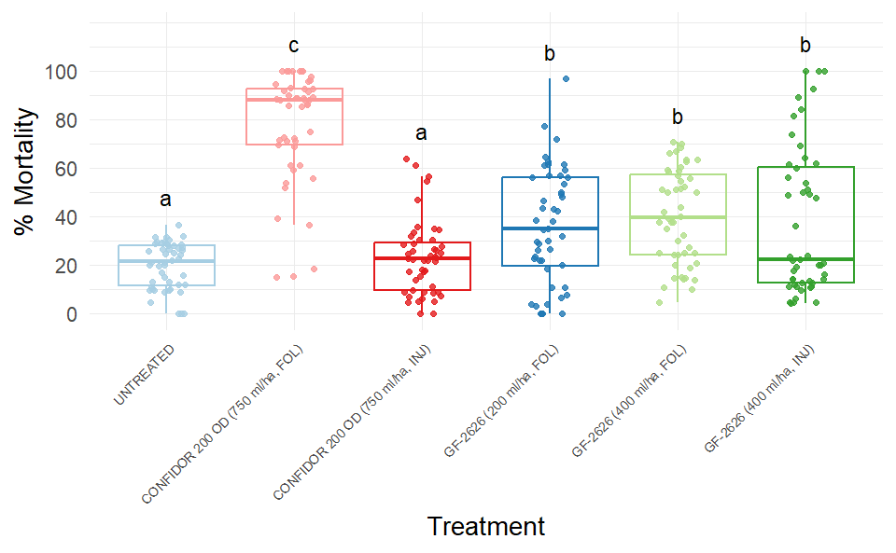
2. Is foliar application or trunk injection more efficient for each treatment? (2017)
We can conclude that determining whether a foliar application or a trunk injection is better depends on the treatment applied in 2017.
For the SULFOXAFLOR treatment, this has no statistical effect at all, while it is best to apply the CONFIDOR treatment foliarly.
INJ – trunk injection
FOL – foliar application

Slide 9
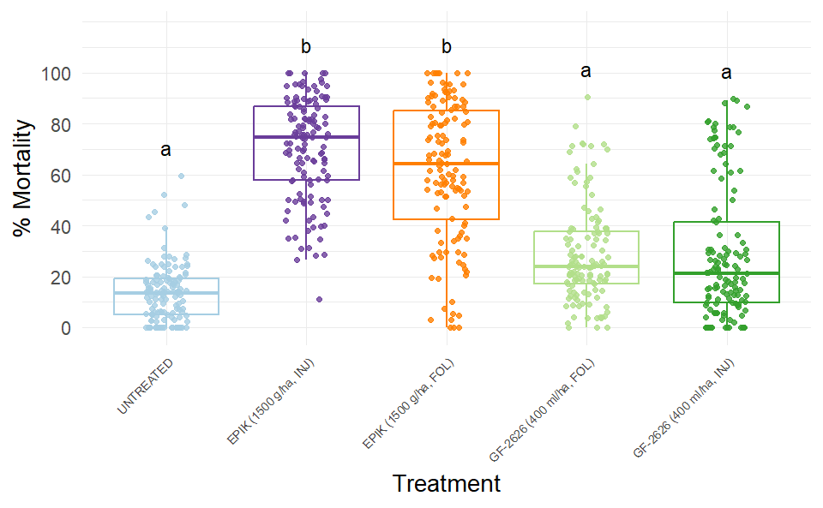
2. Is foliar application or trunk injection more efficient for each treatment? (2018)
We conclude that it is irrelevant (at least statistically) if we make a foliar application or a trunk injection for treatments applied in 2018 regarding mortality.
Overall, we have found that, unless CONFIDOR 200 OD is applied, the method of application has no effect on mortality. However, there appears to be a general, non-statistical trend suggesting that foliar application tends to be the most effective.
INJ – trunk injection
FOL – foliar application

Slide 10
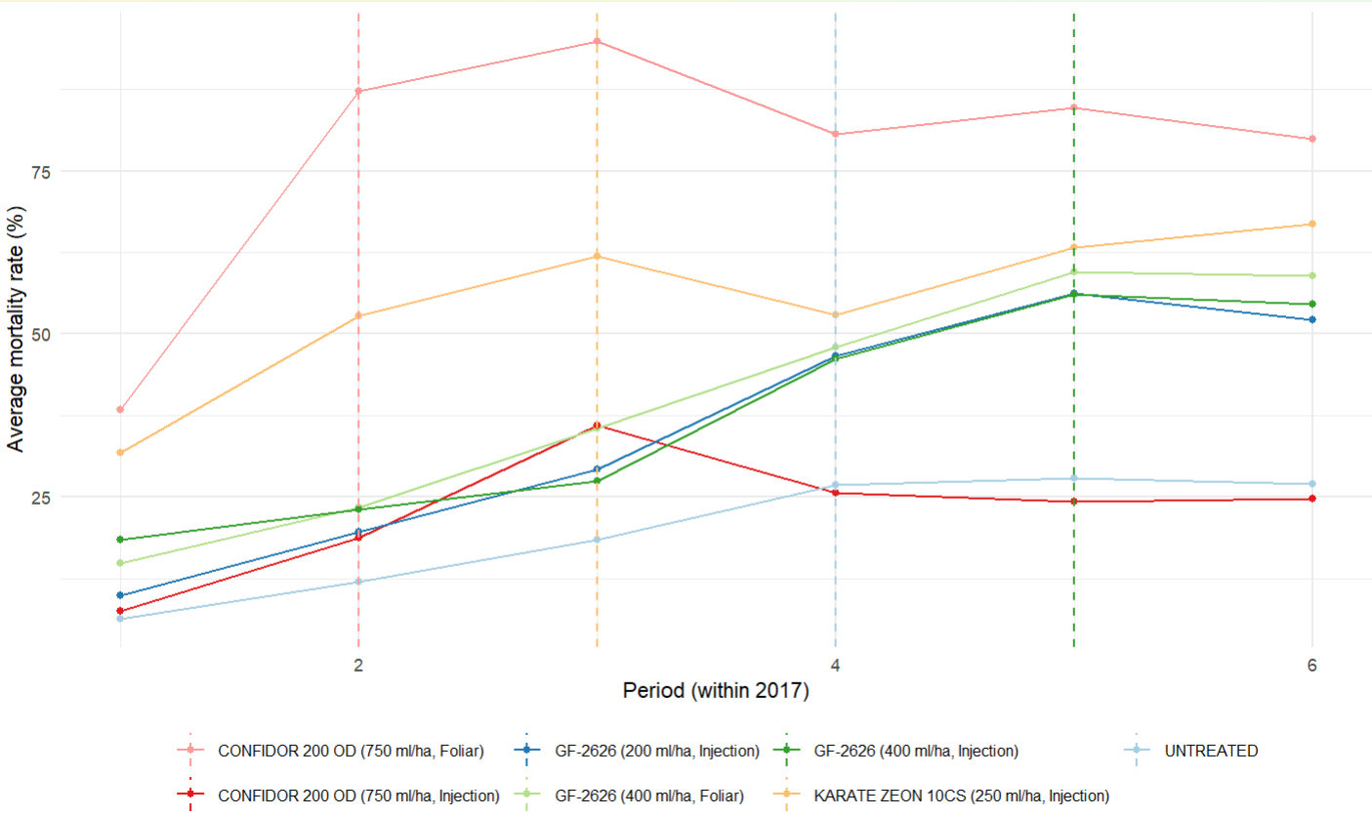
3. How persistent is each treatment and which of them is more persistent on time?
The graph shows average mortality rate by period within 2017.
CONSIDERED VARIABLES
Average mortality at the elbow point (m_elbow)
Elbow point: The point on the curve where the rate of change shifts, creating the most pronounced bend.
Average mortality at the final point (m_final)
Δ_elbow = m_elbow – m_final
AUC (Area under the curve)

Slide 11
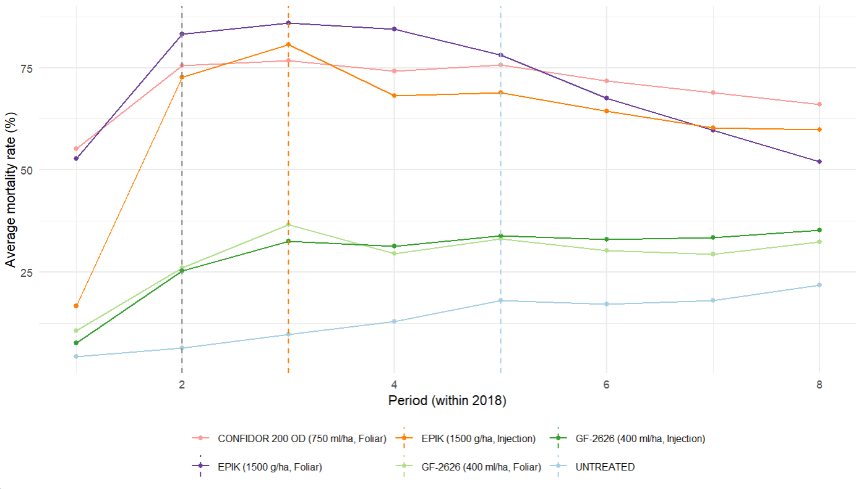
3. How persistent is each treatment and which of them is more persistent on time?
The graph shows average mortality rate by period within 2018.

Slide 12
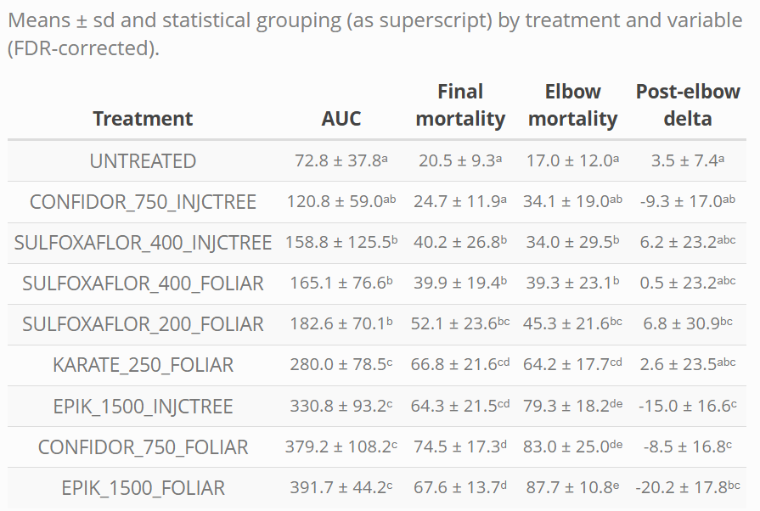
3. How persistent is each treatment and which of them is more persistent on time?
Table showing statistical grouping of treatments using 4 LMM models and mean and standard deviation for each variable.

Slide 13
3. How persistent is each treatment and which of them is more persistent on time?
Table showing statistical grouping of treatments using 4 LMM models and mean and standard deviation for each variable.

Slide 14
3. How persistent is each treatment and which of them is more persistent on time?
Table showing statistical grouping of treatments using 4 LMM models and mean and standard deviation for each variable.

Slide 15
3. How persistent is each treatment and which of them is more persistent on time?
Table showing statistical grouping of treatments using 4 LMM models and mean and standard deviation for each variable.

Slide 16
3. How persistent is each treatment and which of them is more persistent on time?
Table showing statistical grouping of treatments using 4 LMM models and mean and standard deviation for each variable.

Slide 17
3. How persistent is each treatment and which of them is more persistent on time?
Table showing statistical grouping of treatments using 4 LMM models and mean and standard deviation for each variable.

Slide 18
3. How persistent is each treatment and which of them is more persistent on time?
Table showing statistical grouping of treatments using 4 LMM models and mean and standard deviation for each variable.

Slide 19
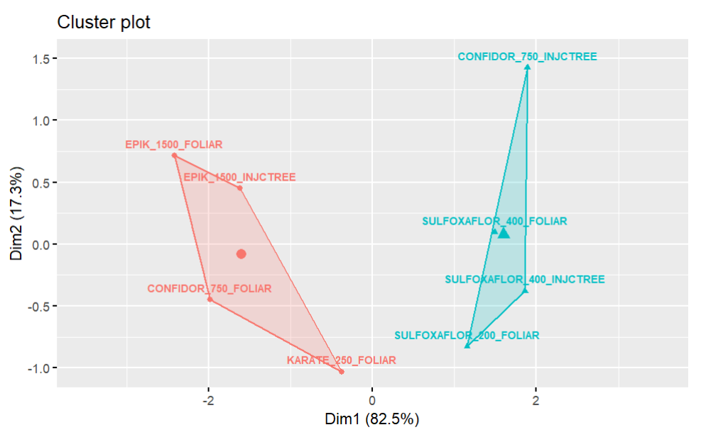
3. How persistent is each treatment and which of them is more persistent on time?
Summarizing all treatments into two clusters (the optimal number), we observe two main groups:
High efficacy, moderate-to-low persistence: red cluster
Low efficacy, moderate-to-high persistence: blue cluster
DIM1 primarily represents efficacy and shows a moderate positive correlation with persistence. DIM2 mainly reflects persistence, distinguishing treatments within each cluster.
-
+
persistence
+
-
INJCTREE – trunk injection
FOLIAR – foliar application
efficacy

Slide 20
Final conclusions
We see two main groups of treatments:
a group associated with a higher effect on mortality and relatively low persistence (KARATE ZEON 200 is a bit more persistent on average, though)
a group associated with a lower effect on mortality and slightly better persistence (yet variable)
Efficacy (or effectiveness) separates these groups more clearly than persistence does, as persistence shows much greater variability across treatments. However, there is a trend: treatments with slightly higher average persistence (e.g., Δ_elbow) tend to have lower average efficacy.
CONFIDOR 200 OD and KARATE ZEON 10 CS, both applied foliarly, appear to be the most effective overall, achieving higher scores in both efficacy and persistence. EPIK treatments also perform well, but are associated with lower average persistence (i.e., a more rapid decline in mortality over time).
On the other hand, CONFIDOR 200 OD applied via trunk injection seems to be the least effective treatment of all.
SUMMARY OF CLUSTERS
EFFICACY VS. PERSISTENCE
BEST-PERFORMING TREATMENTS
WORST-PERFORMING TREATMENTS

Slide 21
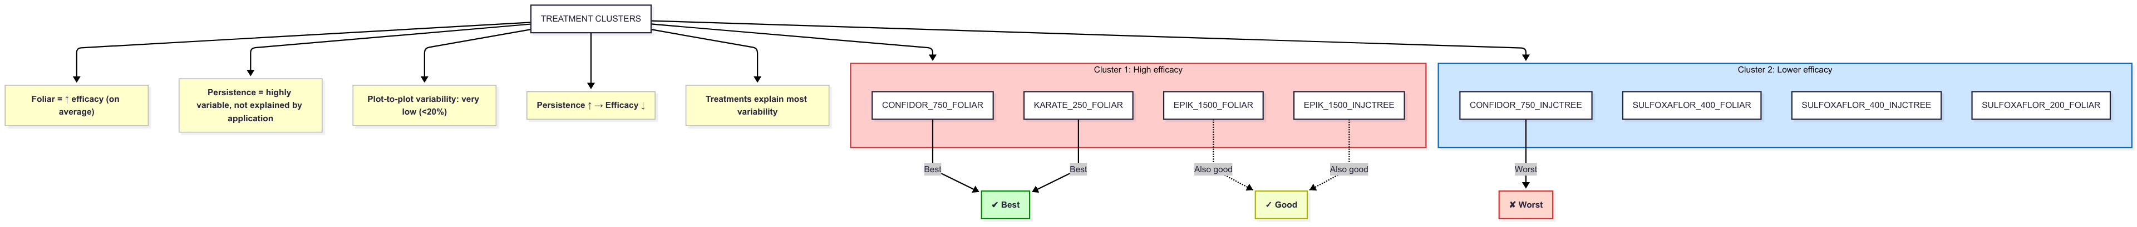
Final conclusions
The mode of application generally has a minor (statistically non-significant) effect on mortality rate, except for CONFIDOR 200 OD. Nevertheless, foliar applications tend to be slightly more effective on average and show less variability in mortality rates (i.e., lower standard deviation).
And finally, variability between plots is generally very low to low, slightly higher in 2018 than in 2017, but it just accounts for less than 1/5 of the total variability explained by our models and very low compared to the overall variability. Treatments explain a much higher proportion of it.
MODE OF APPLICATION
VARIABILITY BETWEEN PLOTS

Slide 22
APPENDIX: TABLE AND CODES OF TREATMENTS IN 2017
2017 Treatments
Trt Num | Appl Code | Treatment Name | Material Name | Form Conc | Conc Unit | Form Type | Rate | Rate Unit | Appl Method
1 | B | SULFOXAFLOR | GF-2626 | 120 | g ai/l | SC | 200 | ml pr/ha | FOLIAR
2 | B | SULFOXAFLOR | GF-2626 | 120 | g ai/l | SC | 400 | ml pr/ha | FOLIAR
3 | A | SULFOXAFLOR | GF-2626 | 120 | g ai/l | SC | 400 | ml pr/ha | INJCTREE
4 | B | CONFIDOR 200 OD | CONFIDOR 200 OD | 200 | g ai/l | OD | 750 | ml pr/ha | FOLIAR
5 | A | CONFIDOR 200 OD | CONFIDOR 200 OD | 200 | g ai/l | OD | 750 | ml pr/ha | INJCTREE
6 | B | LAMBDA-CYHALOTHRIN | KARATE ZEON 10CS | 100 | g ai/l | CS | 250 | ml pr/ha | FOLIAR
7 | B | UNTREATED | UNTREATED

Slide 23
APPENDIX: TABLE AND CODES OF TREATMENTS IN 2018
2017 Treatments
Trt Num | Appl Code | Treatment Name | Material Name | Form Conc | Conc Unit | Form Type | Rate | Rate Unit | Appl Method
1 | A | CONFIDOR 200 OD | CONFIDOR 200 OD | 200 | g ai/l | OD | 750 | ml pr/ha | FOLIAR
2 | A | SULFOXAFLOR | GF-2626 | 120 | g ai/l | SC | 400 | ml pr/ha | FOLIAR
3 | A | EPIK | EPIK | 50 | g ai/kg | WP | 1500 | g pr/ha | FOLIAR
4 | B | SULFOXAFLOR | GF-2626 | 120 | g ai/l | SC | 400 | ml pr/ha | INJCTREE
5 | B | EPIK | EPIK | 50 | g ai/kg | WP | 1500 | g pr/ha | INJCTREE
6 | B | UNTREATED | UNTREATED

